Slide 1
PRESENTATION ON PROJECT REPORT Student Attrition Prediction System
Represented By:
Varun Borhade
Ganesh Bhoi

Slide 2
Problem Statement:
In educational institutions, student attrition is a significant concern. The institute is facing challenges in predicting and preventing student dropouts. The project aims to develop a system that can identify students at risk of leaving the institute, allowing for timely intervention and support.

Slide 3
Solution:
The proposed solution involves the implementation of a predictive model using machine learning algorithms. By analyzing various factors such as academic performance, attendance, and socio-economic background, the system provides actionable insights to help the institute take preventive measures and improve student retention.

Slide 4
Data Source:
The dataset for this project was manually created, incorporating relevant features like student test marks, attendance records, and personal information based on the institute's requirements.

Slide 5
Libraries and Tools Used in Project:
The project utilized the following libraries and tools:
Python (programming language)
Pandas, NumPy (data manipulation)
Scikit-learn (machine learning tools)
PyCharm (integrated development environment)
Flask (web framework for deploying the prediction system)

Slide 6
Algorithm Used
There are three types of algorithm used in this project :
Logistic Regression
Naive Bayes
Decision Tree

Slide 7
1) Logistic Regression
Logistic Regression is a statistical method for analyzing a dataset in which there are one or more independent variables that determine an outcome. It is widely used for binary classification problems. The logistic function, also known as the sigmoid function, is employed to constrain the output between 0 and 1, representing the probability of the positive class

Slide 8
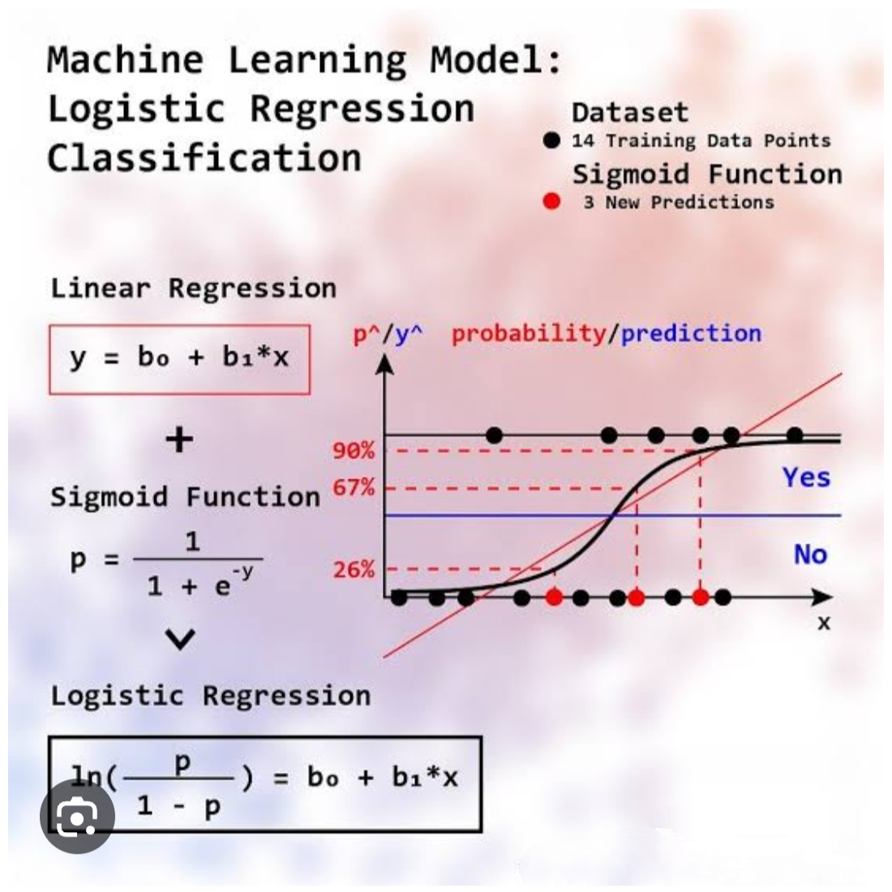

Slide 9
Advantages & Disadvantages of Logistic Regression:
Advantages:
Simple and interpretable.
Efficient for binary classification tasks.
Requires relatively low computational resources.
Disadvantages:
Assumes a linear relationship between features and output.
May not capture complex non-linear patterns.

Slide 10
2) Naive Bayes:
Naive Bayes is a probabilistic model based on Bayes' theorem with the naive assumption of feature independence. It's particularly useful for text classification problems, spam filtering, and other tasks involving categorical features. Despite its simplicity, Naive Bayes often performs well in practice.

Slide 11
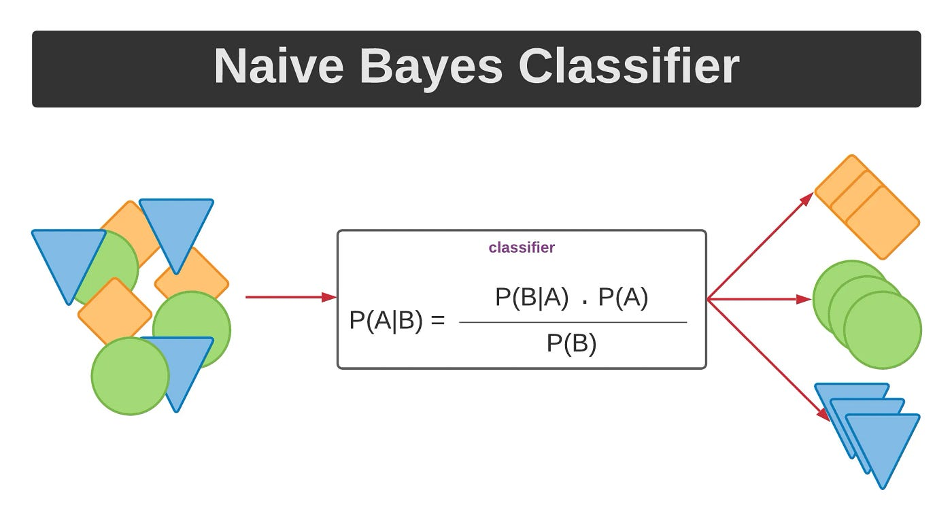

Slide 12
Advantages & Disadvantages of Naive Bayes:
Advantages:
Fast, especially with high-dimensional data.
Handles categorical features well.
Simple and easy to implement.
Disadvantages:
Assumes independence between features, which may not always hold.
May not perform well with highly correlated features.

Slide 13
3) Decision Tree:
Decision Trees are a non-linear model that recursively splits the data based on feature conditions to create a tree-like structure for decision-making. Each internal node represents a decision based on a feature, and each leaf node represents the predicted outcome. Decision Trees are intuitive and can capture complex relationships in data.

Slide 14
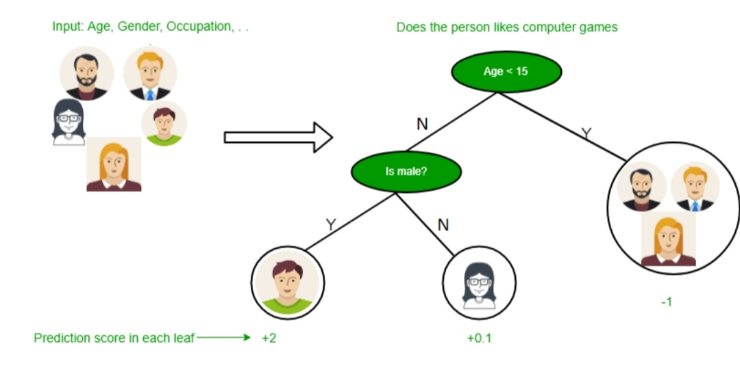

Slide 15
Advantages & Disadvantages of Decision Tree:
Advantages:
Intuitive and easy to understand.
Captures complex relationships in data.
Provides insights into feature importance.
Disadvantages:
Prone to overfitting, especially with deep trees.
Sensitive to small variations in the training data.

Slide 16
Scope of Improvement:
Fine-tune model hyperparameters for better performance.
Experiment with ensemble methods to enhance predictive accuracy.

Slide 17
Reference:
The dataset was specifically created for this project based on the institute's requirements. Additionally, insights from the project draw on relevant literature in the field of student attrition.

Slide 18
Thank You

